Slide 1
Welcome to html
By Sovann Sok

Slide 2
Html contents.
The video……………………………………………………………………………………….1-3
About html……………………………………………………………………………….3-5
Learning About html………………………………………………………………...6-8
Html Introduction……………………………………………………………………..8-11
Html joiners……………………………………………………………………………...11-14
Html Joiners total……………………………………………………………………..14-16
Best Coding programs……………………………………………………………….16-18
About Sovann Coding………………………………………………………………18-20
Index………………………………………………………………………………………….20-21

Slide 3
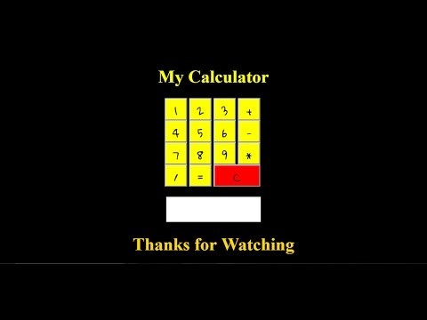
The video

Slide 4
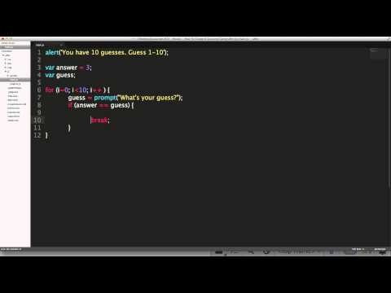
…Continued

Slide 5

…Continued

Slide 6

About HTML You can copy which control + c paste you press control + v to paste
This Photo by Unknown Author is licensed under CC BY-SA

Slide 7
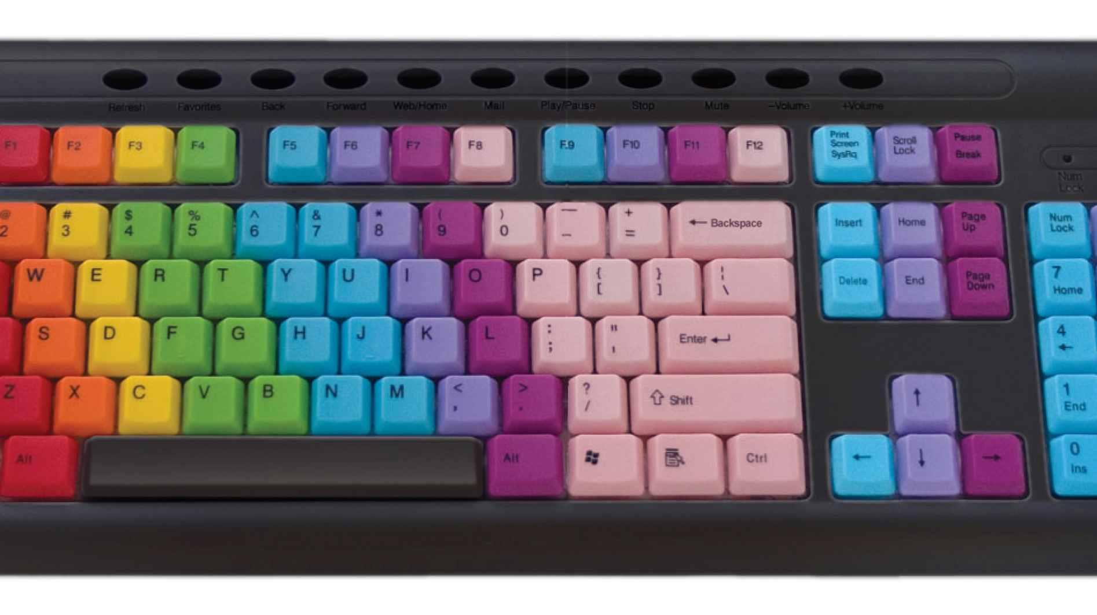
…Continued
Look at this key board
This Photo by Unknown Author is licensed under CC BY-SA

Slide 8
Learn About html

